Slide 1

A Data-Driven Analysis of COVID-19's Evolution and Impact
Submitted By:
Kamini Suresh Yelamar
INFO 5709 : Data Visualization and Communication (Fall 2023)

Slide 2
Contents
Problem Statement
Motivation
Approach
Research Questions
Results
Future Work
INFO 5709 : Data Visualization and Communication (Fall 2023)

Slide 3
Problem Statement
The COVID-19 pandemic has led to significant worldwide health and economic challenges
In order to make well-informed policy decisions, it is essential to understand the virus's effects and its distribution.
To elucidate patterns related to COVID-19, insights derived from data-driven approaches are indispensable.
INFO 5709 : Data Visualization and Communication (Fall 2023)

Slide 4

Motivation
The COVID-19 pandemic stands out as one of the most profound global health crises in recent history
With the ongoing progression of the pandemic, vast amounts of COVID-19 data are collected on a daily basis.
To comprehend the impact of this data on global health, it necessitates thorough analysis and effective visualization.
INFO 5709 : Data Visualization and Communication (Fall 2023)

Slide 5
Approach
Data carpentry and analysis on COVID-19 datasets in PowerBI
Dataset
Techniques:
- Geographical Analysis,
- Exploratory Analysis
- Statistical Modeling
Trend and Spread Pattern Analysis
- Covid 19
- Trends
- Time
- Age
INFO 5709 : Data Visualization and Communication (Fall 2023)

Slide 6
Research Questions
1. What was the overall spread across the globe?
2. Does age play an important role in Covid-19 Death?
3. Has the symptomatology of COVID-19 exhibited any changes or developmental progressions throughout the course of the pandemic?
INFO 5709 : Data Visualization and Communication (Fall 2023)

Slide 7
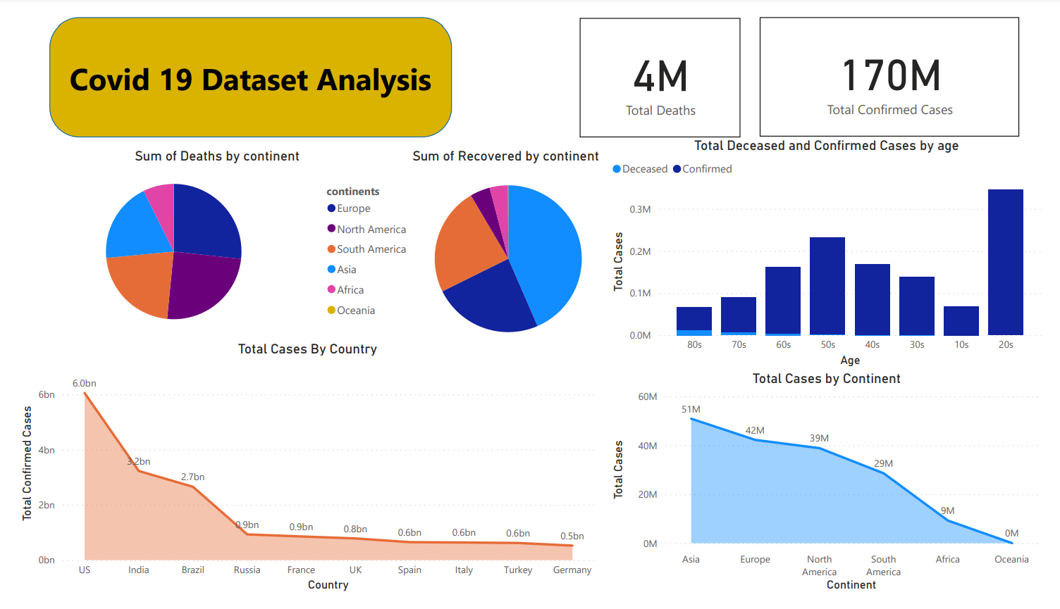
Results
INFO 5709 : Data Visualization and Communication (Fall 2023)

Slide 8
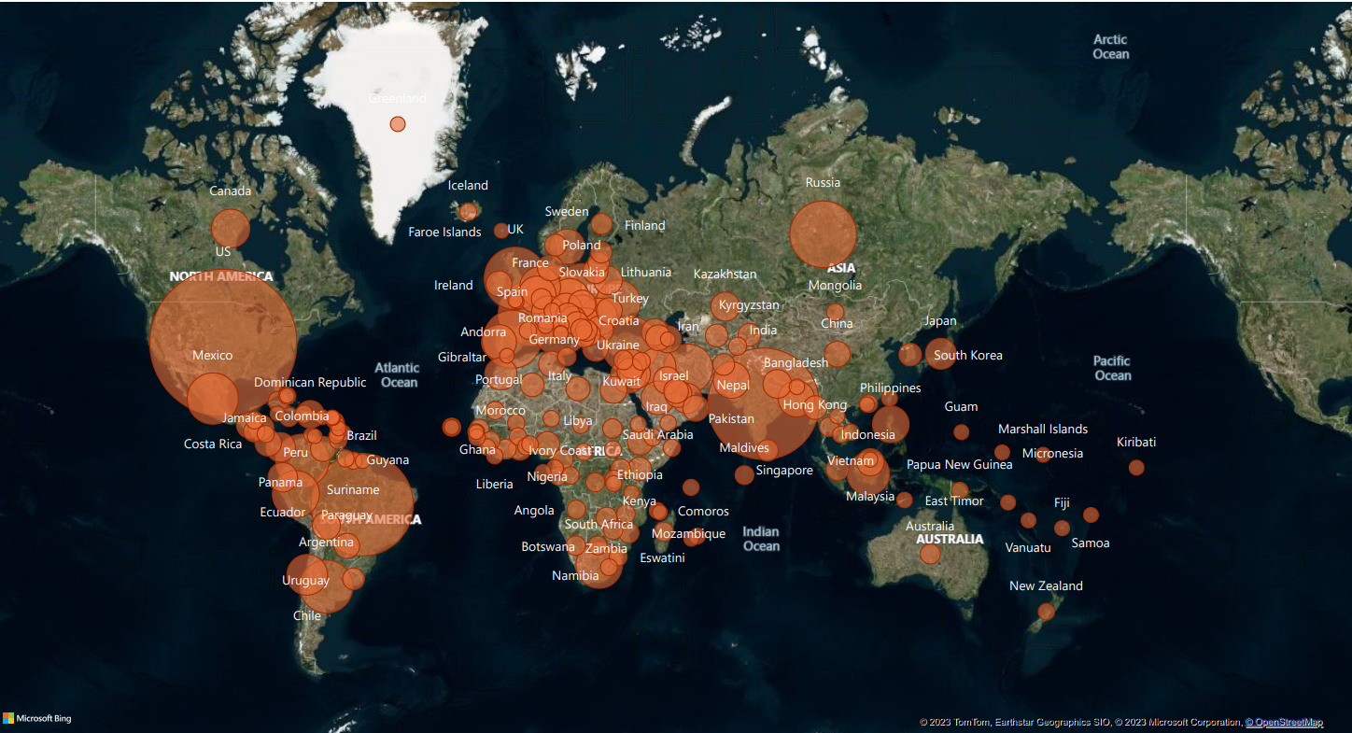
INFO 5709 : Data Visualization and Communication (Fall 2023)

Slide 9
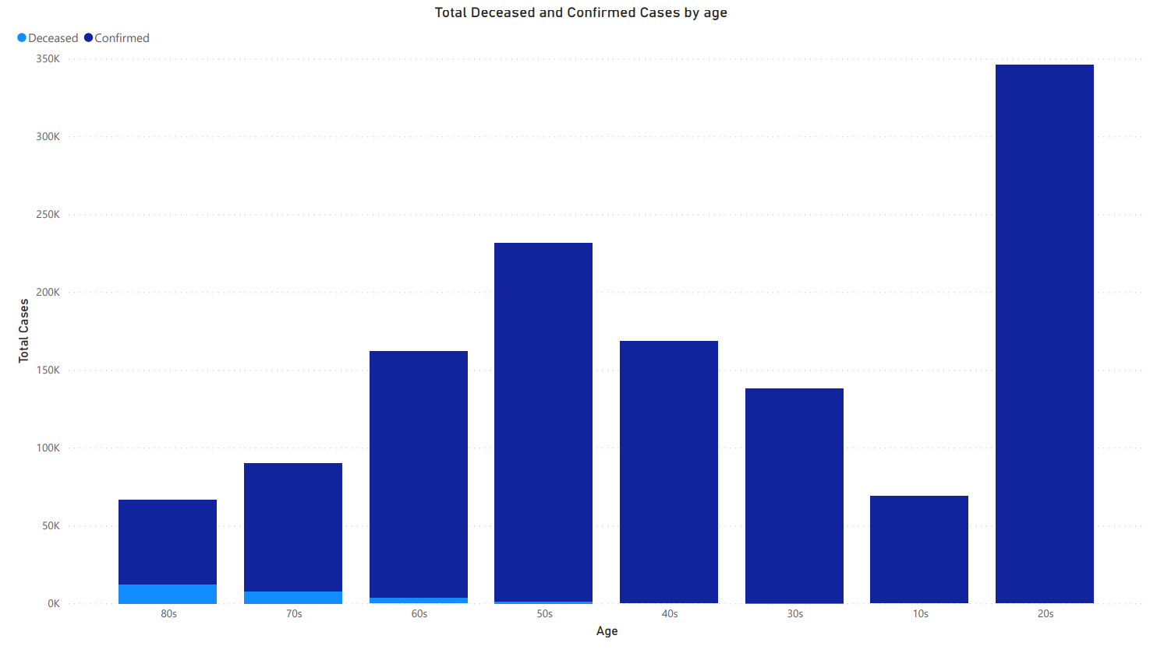
INFO 5709 : Data Visualization and Communication (Fall 2023)

Slide 10
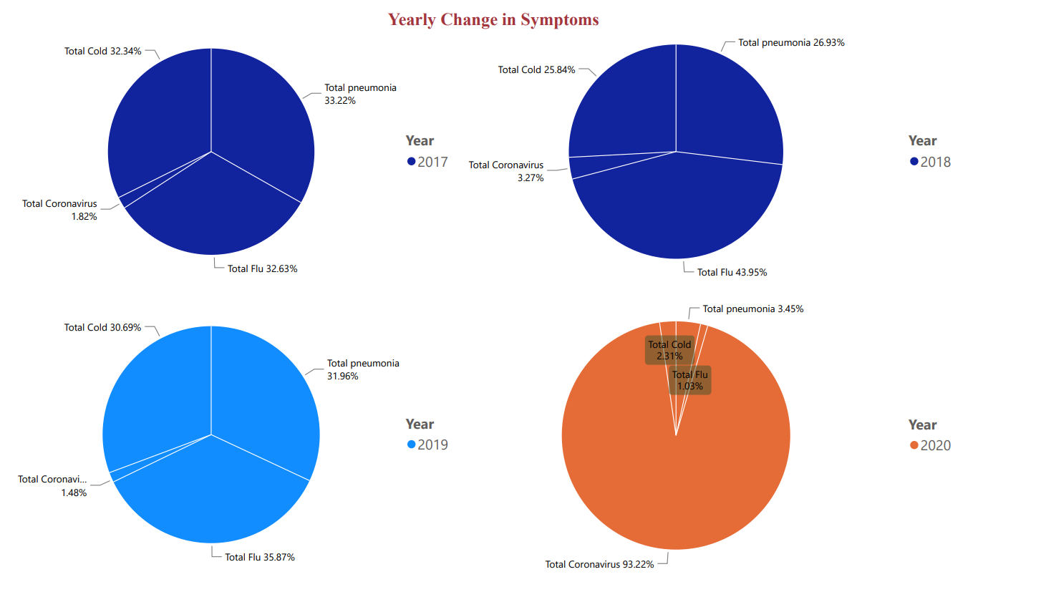
INFO 5709 : Data Visualization and Communication (Fall 2023)

Slide 11
FUTURE WORK
Regression, clustering, and neural networks are examples of advanced models.
Real-time monitoring and forecasting should be operationalized.
INFO 5709 : Data Visualization and Communication (Fall 2023)

Slide 12
Thank You!

